Slide 1
AAPA Environment Committee
April 28, 2017
Chris Cannon
Director of Environmental Management
Port of Los Angeles
Heather Tomley
Director of Environmental Planning
Port of Long Beach

Slide 2
Combined 2015 Air Emissions Results
Diesel Particulate Matter:
DOWN
Nitrogen Oxides:
DOWN
50%
84%
2014
2023
22%
59%
Sulfur Oxides:
DOWN
2014
72%
2023
77%
Greenhouse Gases:
DOWN
97%
12%
7%
2014
2023
TEUs
UP
93%
93%

Slide 3
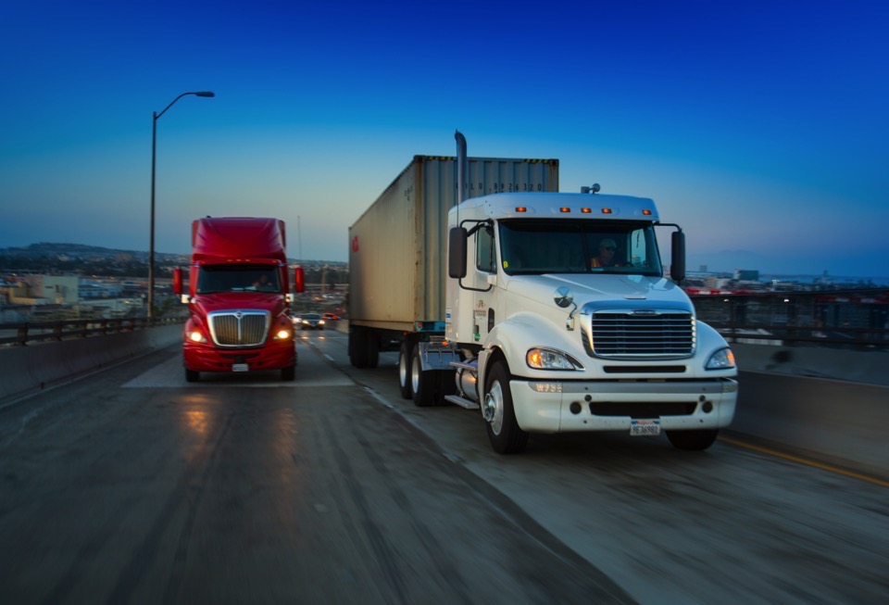
Heavy-Duty Trucks
Advance the Clean Trucks Program and transition to zero-emission trucks by 2035
Adopt a “Green Truck Priority” program at terminals to accelerate deployment of zero and near-zero emission trucks

Slide 4
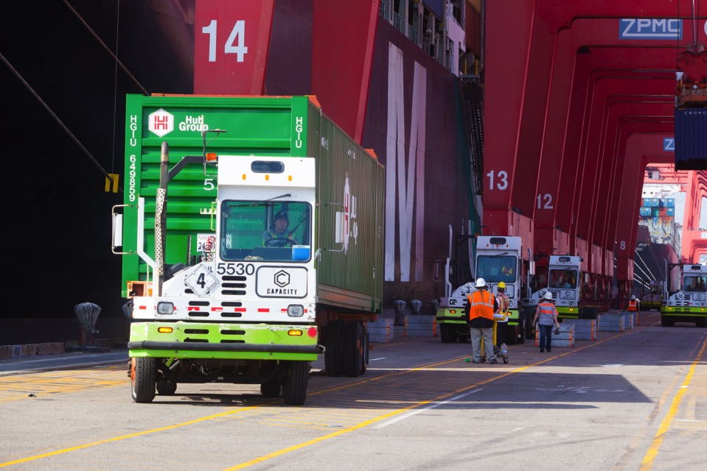
Terminal Equipment
Transition to zero emissions terminal equipment by 2030

Slide 5
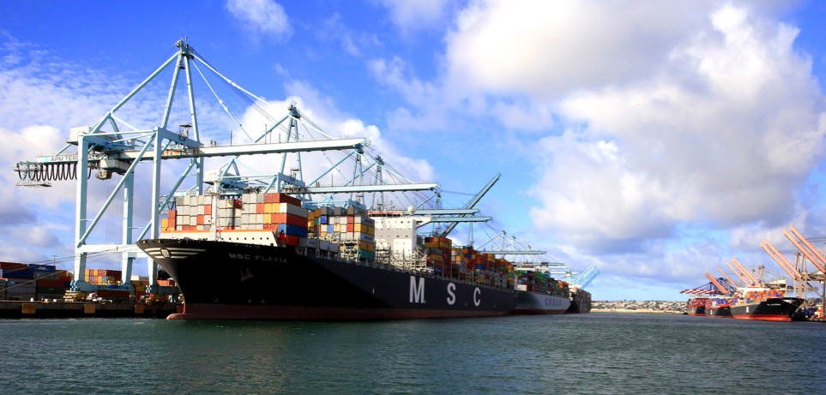
Ocean-Going Vessels
Expand vessel speed reduction compliance to 40 nautical miles
Use at-berth emission reduction technologies
Incentivize energy efficiency upgrades and clean technologies
Develop a Clean Ship Program to transition the oldest, most polluting ships out of the fleet

Slide 6
Additional Draft 2017 CAAP Highlights
Expand use of on-dock rail
Accelerate deployment of cleaner harbor craft engines
Encourage improvements in freight efficiencies
Develop Green Terminal Recognition Program
Ensure energy infrastructure is available to support use of cleaner technologies

Slide 7
Outreach To Date
Environmental Regulatory Agencies
Community
Trucking Industry
Shipping Lines
Environmental Organizations
Railroads
Greater Los Angeles Business Community
Marine Terminal Operators

Slide 8
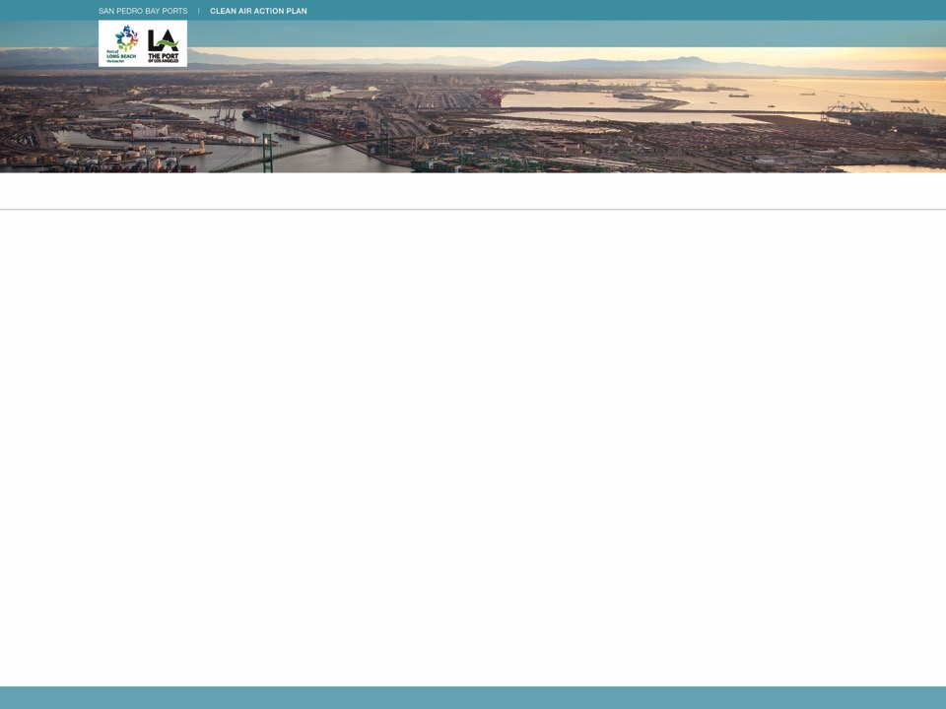
Recurring Themes
accountability
feasibility assessments
infrastructure
interim targets
zero-emissions
costs
regulatory coordination
stakeholder process
more time to plan
community health
technology
more detail
economic competitiveness
transparency
emission reductions

Slide 9
Current Status
Preparing updated Draft CAAP 2017
Continue to seek input
Respond to comments from stakeholders and modify strategies as needed
Incorporate information from additional analyses
Develop supporting materials
Monitor and participate in regulatory efforts
Notes:
Supporting materials:
Feasibility Assessment Framework
CAAP Costs Analysis
Economic Analysis and Jobs Impacts
Emissions Benefits

Slide 10
For More Details
CAAP 2017 Discussion Document available at:
www.cleanairactionplan.org
Please provide comments:
caap@cleanairactionplan.org

